Slide 1
Topic: Multi-core Parallel Programming with MATLAB/Simulink
- Suryakiran George

Slide 2
Basics of Multi-core Programming
A multi-core processor system is a single processor with multiple execution cores in one chip.
Features:
- concurrent systems that have multiple tasks executing in parallel
- splits the program as multiple parallel tasks executing simultaneously; thus reducing execution time.
increases the computing power without having to have a higher clock speed
only beneficial if enough of the application software can be parallelized ( for context refer to Amdahl’s law)

Slide 3
Types of Parallelism
- Data Parallelism
- Task Parallelism
- Pipe-lining

Slide 4
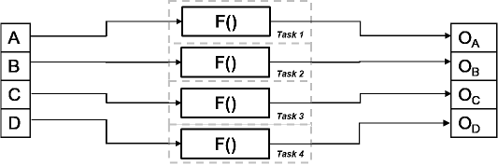
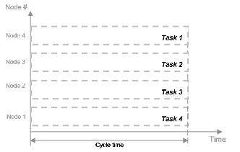
Data Parallelism
processes multiple pieces of data independently in parallel
4x improvement!

Slide 5
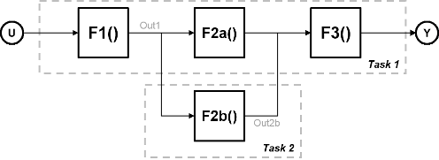
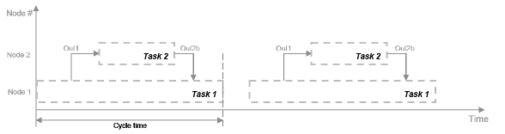
Task Parallelism
Distributes tasks within an application across multiple processing nodes. Some tasks can have data dependency on others, so all tasks do not run at exactly the same time.

Slide 6
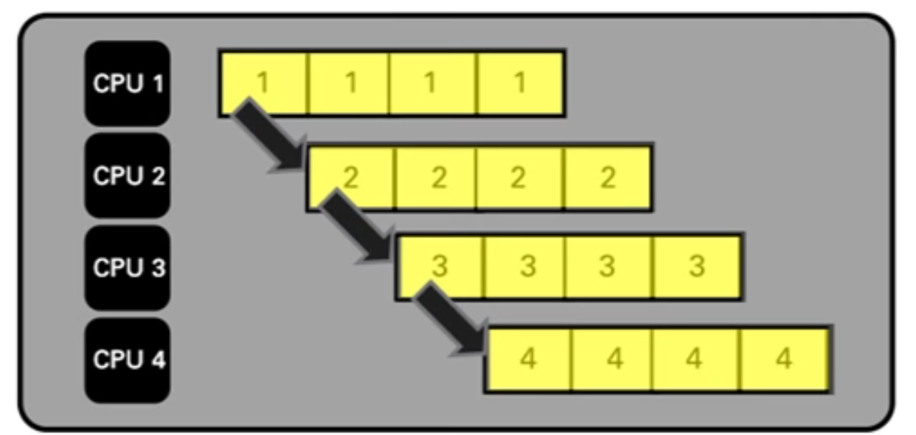
Pipe-lining
Assembly line approach
Benefits seen after 4 steps!

Slide 7
Steps in Multi-core Programming
1) Partitioning - Define a large number of smaller tasks in order to yield a fine-grained decomposition of the problem
2) Communication - The tasks generated by a partition are intended to execute concurrently but, in general, not independently. Data must then be transferred between tasks to allow computation to proceed
3) Combining - Decisions made in the partitioning and communication phases are reviewed to identify a grouping that will execute efficiently on the multi-core processor.
4) Mapping - This stage consists of determining where each task is to execute.

Slide 8
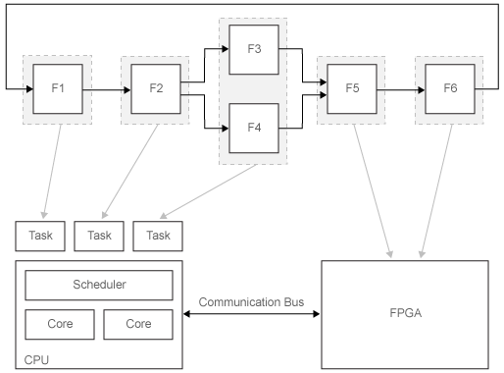
System Partitioning for Parallelism
Partitioning designates areas of your system for concurrent execution.

Slide 9
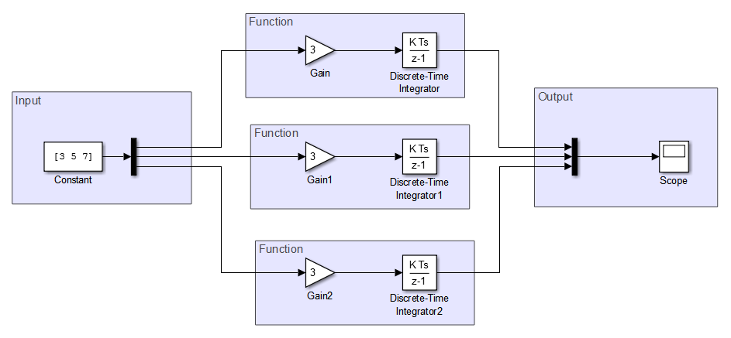
Implementing Data Parallelism in Simulink
More details: https://www.mathworks.com/help/simulink/ug/implement-data-parallelism-in-simulink.html

Slide 10
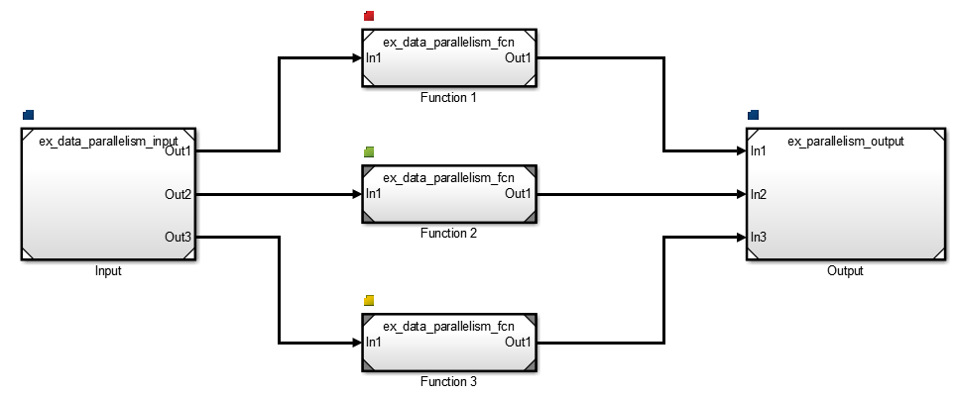
Steps for Parallel Execution
Map each referenced block to individual tasks
Step by step configuration steps are available on Mathworks website.

Slide 11
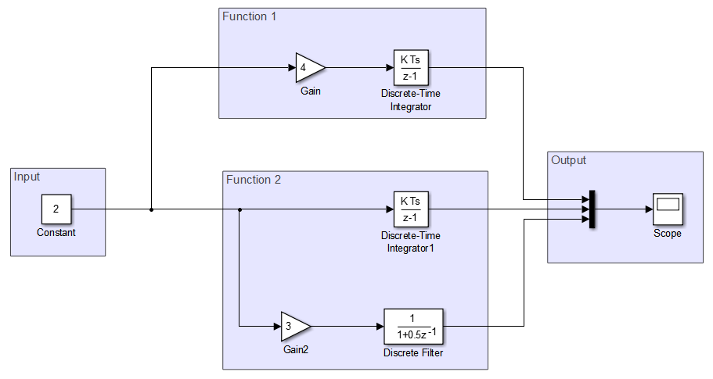
Implementing Task Parallelism in Simulink

Slide 12
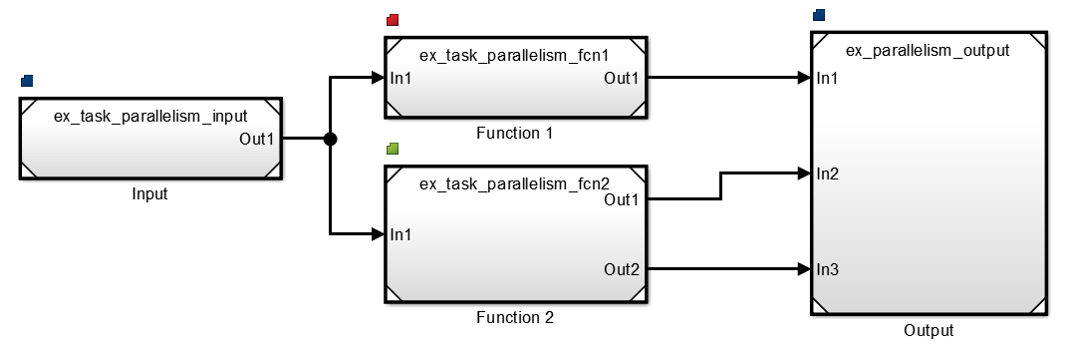
Steps for Parallel Execution
Map each referenced block to individual tasks
Step by step configuration steps are available on Mathworks website.

Slide 13
Multi-core Programming Workflow in Simulink
Partitioning
Mapping
Profiling
Partitioning helps designate different regions of the model as tasks, independent of the details of the embedded multi-core processing hardware. This helps to arrange the content and hierarchy of the model to best suit the needs of the application.
In a partitioned system, mapping assigns partitions to processing elements in the embedded processing system. While creating the model, one need not track the partitions or data transfer between them because the tool does this work.
Profiling simulates deployment of the application under typical computational loads. It enables to determine the partitioning and mapping of the model that gives the best performance, before it’s deployed to the hardware.

Slide 14
Summary – Steps
Model Configuration – Break down of model into fine grain tasks
Multi core configuration – Specify the number of cores and assigning tasks to core; done in Simulink Configuration Parameters
Solver Configuration – Choose the appropriate solver and periodicity settings
Dependency Management – Avoid concurrency issues by proper data synchronization
Simulation & Code generation – Run the simulation and generate code for the multi core hardware.
Performance Analysis - Simulink provides various tools and metrics to help you measure the speedup achieved through multi core execution.

Slide 15
References
Www.mathworks.com
Www.youtube.com

Slide 16
Notes
Consider this system. F1–F6 are functions of the system that can be executed independently. An arrow between two functions indicates a data dependency. For example, the execution of F5 has a data dependency on F3.
Execution of these functions is assigned to the different processor nodes in the target system. The gray arrows indicate assignment of the functions to be deployed on the CPU or the FPGA. The CPU scheduler determines when individual tasks run. The CPU and FPGA communicate via a common communication bus.

